Slide 1


Slide 2
UML Use Case Diagrams
Communication
association
Withdraw
Cash
(Sub)system
boundary
Check
Balance
CardHolder
Actor
Use case

Slide 3
Basic Notation
Use case diagrams show:
  Actors: people or other systems interacting with system being modelled
  Use cases: represent sequences of actions carried out by the system
  Communication: between actors and use cases
Withdraw
Cash

Slide 4
Behaviour Specifications
Document sequence of actions carried out by system to realize a use case
  Other UML diagrams: e.g.
    sequence diagrams
    activity diagrams
  Textual description:
    use-case descriptions
    use-case scenarios

Slide 5
Simple Use Case Description
Outline of typical course of events:
  The primary “flow” or “path”
ATM system example:
Withdraw Cash:
The card holder selects the withdraw cash menu, which is displayed by the system. The card holder selects an amount of cash. The system debits the user’s account, returns the user’s card and issues the requested money.

Slide 6
Elaborated Use-Case Description
Withdraw Cash: basic course of events
The user selects the cash withdrawal option
The system displays the cash withdrawal menu
The use selects the required amount of cash
The system returns the user’s card
The user takes the card
The system dispenses the cash
The user takes the cash

Slide 7
Alternative Courses of Events
Use case represents a typical case of interaction
For example, there may be many Withdraw Cash scenarios where no cash is withdrawn!
  Card holder has insufficient funds on account
  ATM cannot connect to bank’s system
  ATM does not contain enough cash
  Customer cancels the transaction for some reason

Slide 8
Withdraw Cash - Alternative Course of Events
Withdraw Cash -- insufficient funds available
The user selects the cash withdrawal option
The system displays the cash withdrawal menu
The user selects the required amount of cash
The system reports that there are insufficient funds available and the use case terminates

Slide 9
Relationships Revisited

Slide 10
Other Types of Relationship
Generalizes:
  Permits actors/use cases to inherit properties of more general actors/use cases
Include:
  Permits use case to include functionality of another use case
Extend:
  Allows for optional extensions of use case functionality

Slide 11
Generalized Relationship
BankMember specializes CardHolder
Withdraw
Cash
CardHolder
Check
Balance
Generalizes
Relation
Order Statement
BankMember

Slide 12
Include Relationship
Select Account is included in each of the use cases
Withdraw
Cash
«include»
Check
Balance
«include»
Select Account
BankMember
Order Statement
«include»
Note: include was formerly called uses

Slide 13
Include Relationship
Check Balance: basic course of events
The user performs the ‘Select Account’ use case
The system displays the main menu
The user selects the check balance option
The system displays the user’s balance

Slide 14
Extend Relationship
CardHolder has the option of printing out a balance when the Check Balance use case is invoked.
Print Balance
«extend»
Check
Balance
Extend relationship
CardHolder

Slide 15
Extend Relationship
Check Balance: basic course of events (revised)
The user performs the ‘Select Account’ use case
The system displays the main menu
The user selects the display balance option
The system displays the user’s balance
The user optionally performs the ‘Print Balance’ use case.

Slide 16
Summary
Use case analysis often a first step in system development:
  provide high-level view of system functionality (what rather than how) and its users
  A use case represents a typical course of events
UML use case diagrams
  Contain actors, use cases and associations
  supported by behaviour specifications (e.g. use-case descriptions)

Slide 17
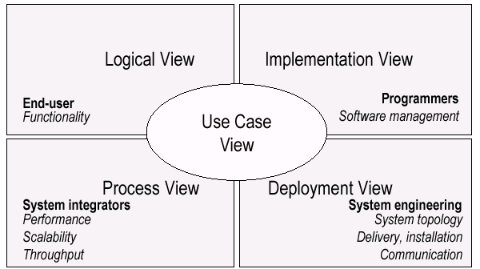
UML Models, Views, Diagrams
UML is a multi-diagrammatic language
  Each diagram is a view into a model
    Diagram presented from the aspect of a particular stakeholder
    Provides a partial representation of the system
    Is semantically consistent with other views
  Example views

Slide 18
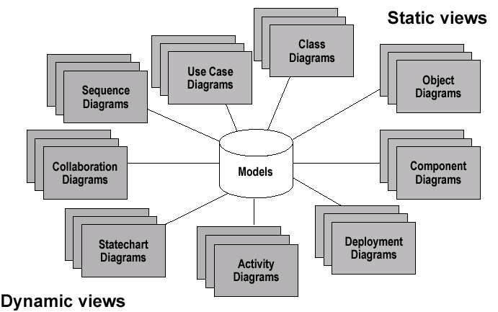
Models, Views, Diagrams

Slide 19
How Many Views?
Views should be used to fit the context
  Not all systems require all views
  Single processor: drop deployment view
  Single process: drop process view
  Very small program: drop implementation view
A system might need additional views
  Data view, security view, …

Slide 20
UML: First Pass
You can model 80% of most problems by using about 20 % UML
We only cover the 20% here

Slide 21
Basic Modeling Steps
Use Cases
  Capture requirements
Domain Model
  Capture process, key classes
Design Model
  Capture details and behaviors of use cases and domain objects
  Add classes that do the work and define the architecture

Slide 22
UML Baseline
Use Case Diagrams
Class Diagrams
Package Diagrams
Interaction Diagrams
  Sequence
  Collaboration
Activity Diagrams
State Transition Diagrams
Deployment Diagrams

Slide 23
Use Case Diagrams
Used during requirements elicitation to represent external behavior
Actors represent roles, that is, a type of user of the system
Use cases represent a sequence of interaction for a type of functionality; summary of scenarios
The use case model is the set of all use cases. It is a complete description of the functionality of the system and its environment
Passenger
PurchaseTicket

Slide 24
Actors
An actor models an external entity which communicates with the system:
  User
  External system
  Physical environment
An actor has a unique name and an optional description.
Examples:
  Passenger: A person in the train
  GPS satellite: Provides the system with GPS coordinates
Passenger

Slide 25
Use Case
A use case represents a class of functionality provided by the system as an event flow.
A use case consists of:
Unique name
Participating actors
Entry conditions
Flow of events
Exit conditions
Special requirements
PurchaseTicket

Slide 26
Use Case Diagram: Example
Event flow:
1. Passenger selects the number of zones to be traveled.
2. Distributor displays the amount due.
3. Passenger inserts money, of at least the amount due.
4. Distributor returns change.
5. Distributor issues ticket.
Name: Purchase ticket
Participating actor: Passenger
Entry condition:
Passenger standing in front of ticket distributor.
Passenger has sufficient money to purchase ticket.
Exit condition:
Passenger has ticket.
Anything missing?
Exceptional cases!

Slide 27
Relationships Revisited

Slide 28
When do I use extends?
The extends arrow (or extends edge) is drawn from a use case X to a use case Y to indicate that the process X is a special case behavior of the same type as the more general process Y.
Used in situations where your system has a number of use cases (processes) that all have some subtasks in common, but each one has something different about it that makes it impossible for you to just lump them all together into the same use case.

Slide 29
Example
Suppose you wanted to add detail to the diagram shown below, representing an airline reservation system. Specifically, what you would like to show is that not all of the seats aboard the airplane are exactly alike (some window and some aisle seats), and sometimes passengers will express a preference for one of these types of seats but not the other. But of course, they cannot just be given their preference right away, because the seat they want might not be available. Therefore, the process of assigning a window seat involves checking for the availability of window seats, whereas the process of assigning an aisle seat involves checking for the availability of aisle seats. But even though these processes are different, they are quite similar in a number of other ways, so it doesn't make sense to ignore their similarities. Fortunately, UML lets us have both: we write that assigning these two types of seats are different processes, but they are similar in that both processes extend a common, more general process (assigning seats.)

Slide 30
Extends
Draw illustrations here

Slide 31
Adding Details to Checkin

Slide 32
The <<extends>> Relationship
<<extends>> relationships represent exceptional or seldom invoked cases.
The exceptional event flows are factored out of the main event flow for clarity.
Use cases representing exceptional flows can extend more than one use case.
The direction of a <<extends>> relationship is to the extended use case
Passenger
PurchaseTicket
<<extends>>
<<extends>>
<<extends>>
OutOfOrder
<<extends>>
TimeOut
Cancel
NoChange

Slide 33
The <<includes>> Relationship
<<includes>> relationship represents behavior that is factored out of the use case.
<<includes>> behavior is factored out for reuse, not because it is an exception.
The direction of a <<includes>> relationship is to the using use case (unlike <<extends>> relationships).
Passenger
PurchaseMultiCard
PurchaseSingleTicket
<<includes>>
<<includes>>
<<extends>>
CollectMoney
<<extends>>
NoChange
Cancel

Slide 34
Use Cases are useful to…
Determining requirements
  New use cases often generate new requirements as the system is analyzed and the design takes shape.
Communicating with clients
  Their notational simplicity makes use case diagrams a good way for developers to communicate with clients.
Generating test cases
  The collection of scenarios for a use case may suggest a suite of test cases for those scenarios.

Slide 35
Use Case Diagrams: Summary
Use case diagrams represent external behavior
Use case diagrams are useful as an index into the use cases
Use case descriptions provide meat of model, not the use case diagrams.
All use cases need to be described for the model to be useful.

Slide 36
Class Diagrams
Gives an overview of a system by showing its classes and the relationships among them.
  Class diagrams are static
  they display what interacts but not what happens when they do interact
Also shows attributes and operations of each class
Good way to describe the overall architecture of system components

Slide 37
Class Diagram Perspectives
We draw Class Diagrams under three perspectives
  Conceptual
    Software independent
    Language independent
  Specification
    Focus on the interfaces of the software
  Implementation
    Focus on the implementation of the software

Slide 38
Classes – Not Just for Code
TariffSchedule
Name
Table zone2price
Enumeration getZones()
Price getPrice(Zone)
TariffSchedule
Attributes
zone2price
getZones()
getPrice()
Signature
Operations
TariffSchedule
A class represent a concept
A class encapsulates state (attributes) and behavior (operations).
Each attribute has a type.
Each operation has a signature.
The class name is the only mandatory information.

Slide 39
Instances
tarif_1974:TariffSchedule
zone2price = {
{‘1’, .20},
{‘2’, .40},
{‘3’, .60}}
An instance represents a phenomenon.
The name of an instance is underlined and can contain the class of the instance.
The attributes are represented with their values.

Slide 40
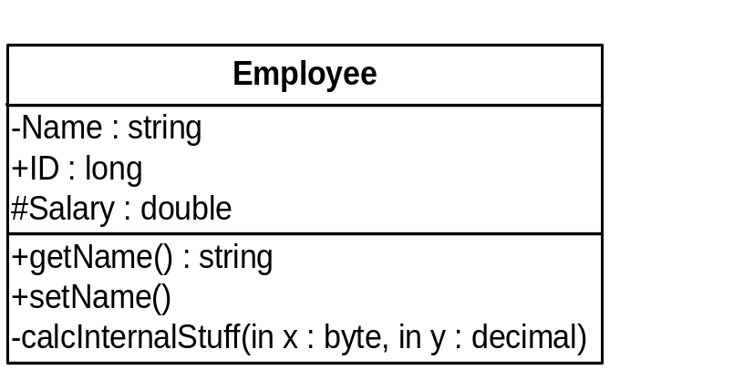
UML Class Notation
A class is a rectangle divided into three parts
  Class name
  Class attributes (i.e. data members, variables)
  Class operations (i.e. methods)
Modifiers
  Private: -
  Public: +
  Protected: #
  Static: Underlined (i.e. shared among all members of the class)
Abstract class: Name in italics

Slide 41
UML Class Notation
Lines or arrows between classes indicate relationships
  Association
    A relationship between instances of two classes, where one class must know about the other to do its work, e.g. client communicates to server
    indicated by a straight line or arrow
  Aggregation
    An association where one class belongs to a collection, e.g. instructor part of Faculty
    Indicated by an empty diamond on the side of the collection
  Composition
    Strong form of Aggregation
    Lifetime control; components cannot exist without the aggregate
    Indicated by a solid diamond on the side of the collection
  Inheritance
    An inheritance link indicating one class a superclass relationship, e.g. bird is part of mammal
    Indicated by triangle pointing to superclass

Slide 42

Binary Association
Binary Association: Both entities “Know About” each other
myB.service();
myA.doSomething();
Optionally, may create an Associate Class

Slide 43

Unary Association
A knows about B, but B knows nothing about A
myB.service();
Arrow points in direction
of the dependency

Slide 44

Aggregation
Aggregation is an association with a “collection-member” relationship
void doSomething()
aModule.service();
Hollow diamond on
the Collection side
No sole ownership implied

Slide 45
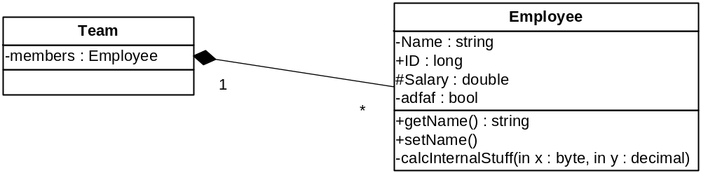
Composition
Composition is Aggregation with:
Lifetime Control (owner controls construction, destruction)
Part object may belong to only one whole object
members[0] =
new Employee();
…
delete members[0];
Filled diamond on side of the Collection

Slide 46
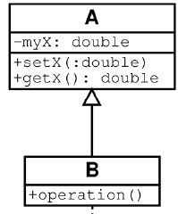
Inheritance
Standard concept of inheritance
Base Class
Derived Class
class B() extends A
…

Slide 47
UML Multiplicities
Links on associations to specify more details about the relationship
Multiplicities | Meaning
0..1 | zero or one instance. The notation n . . m indicates n to m instances.
0..* or * | no limit on the number of instances (including none).
1 | exactly one instance
1..* | at least one instance

Slide 48
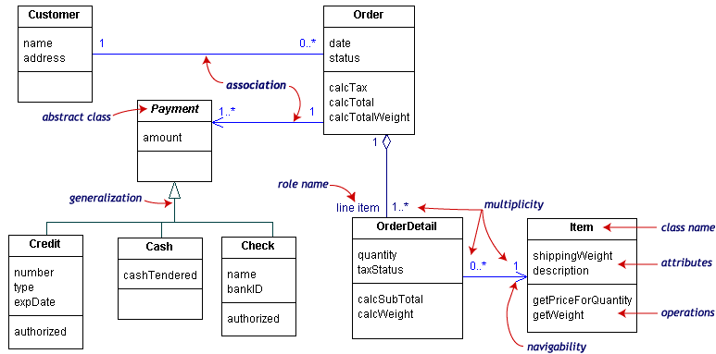
UML Class Example

Slide 49
Association Details
Can assign names to the ends of the association to give further information
Team
-
Employee
group
-
Name
:
string
-
members
:
Employee
-
individual
+
ID
:
long
1
#
Salary
:
double
*
-
adfaf
:
bool
+
getName
() :
string
+
setName
()
-
calcInternalStuff
(
in x
:
byte
,
in y
:
decimal
)

Slide 50
Static vs. Dynamic Design
Static design describes code structure and object relations
  Class relations
  Objects at design time
  Doesn’t change
Dynamic design shows communication between objects
  Similarity to class relations
  Can follow sequences of events
  May change depending upon execution scenario
  Called Object Diagrams

Slide 51
Object Diagrams
Shows instances of Class Diagrams and links among them
  An object diagram is a snapshot of the objects in a system
    At a point in time
    With a selected focus
      Interactions – Sequence diagram
      Message passing – Collaboration diagram
      Operation – Deployment diagram

Slide 52
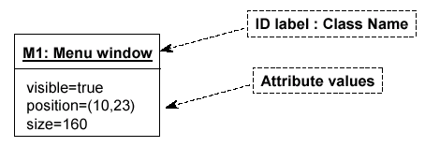
Object Diagrams
Format is
  Instance name : Class name
  Attributes and Values
  Example:

Slide 53
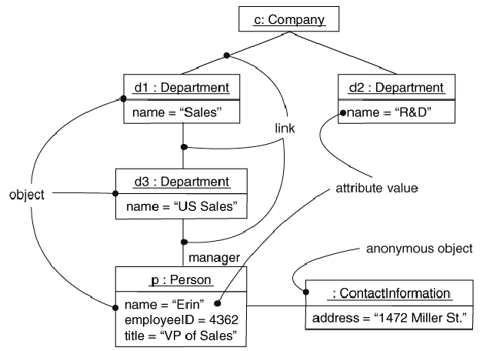
Objects and Links
Can add association type and also message type

Slide 54
Package Diagrams
To organize complex class diagrams, you can group classes into packages. A package is a collection of logically related UML elements
Notation
  Packages appear as rectangles with small tabs at the top.
  The package name is on the tab or inside the rectangle.
  The dotted arrows are dependencies. One package depends on another if changes in the other could possibly force changes in the first.
  Packages are the basic grouping construct with which you may organize UML models to increase their readability

Slide 55
Package Example
DispatcherInterface
Notification
IncidentManagement

Slide 56
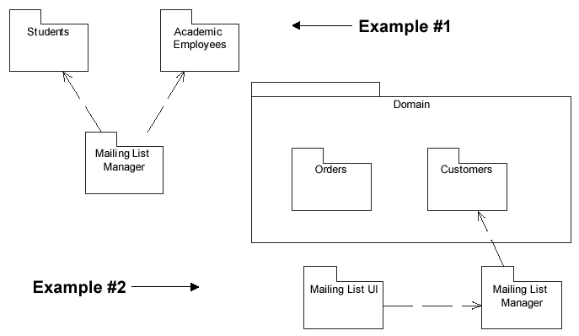
More Package Examples

Slide 57
Interaction Diagrams
Interaction diagrams are dynamic -- they describe how objects collaborate.
A Sequence Diagram:
  Indicates what messages are sent and when
  Time progresses from top to bottom
  Objects involved are listed left to right
  Messages are sent left to right between objects in sequence

Slide 58
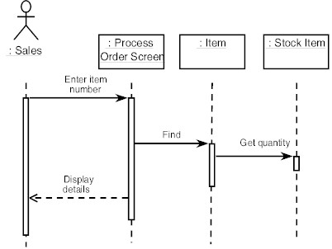
Sequence Diagram Format
Actor from
Use Case
Objects
1
Activation
2
3
4
Lifeline
Calls = Solid Lines
Returns = Dashed Lines

Slide 59
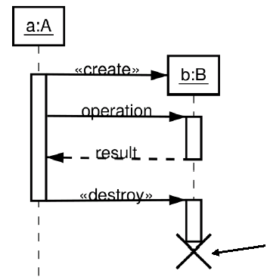
Sequence Diagram : Destruction
Shows Destruction of b
(and Construction)

Slide 60
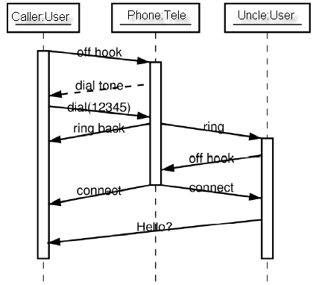
Sequence Diagram : Timing
Slanted Lines show propagation delay of messages
Good for modeling real-time systems
If messages cross this is usually problematic – race conditions

Slide 61
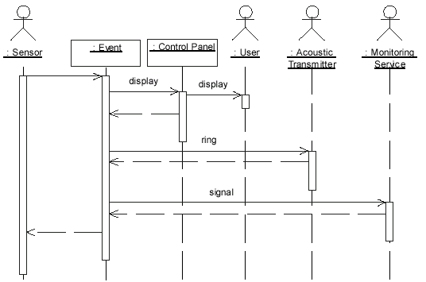
Sequence Example: Alarm System
When the alarm goes off, it rings the alarm, puts a message on the display, notifies the monitoring service

Slide 62
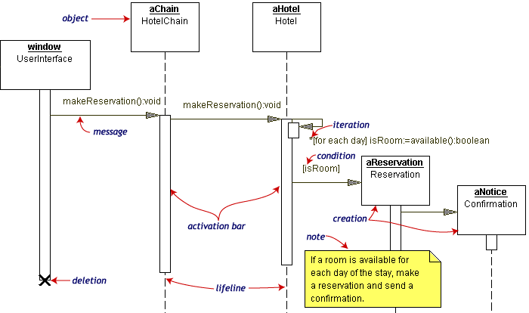
Sequence Diagram Example
Hotel Reservation

Slide 63
Collaboration Diagram
Collaboration Diagrams show similar information to sequence diagrams, except that the vertical sequence is missing. In its place are:
  Object Links - solid lines between the objects that interact
  On the links are Messages - arrows with one or more message name that show the direction and names of the messages sent between objects
Emphasis on static links as opposed to sequence in the sequence diagram

Slide 64
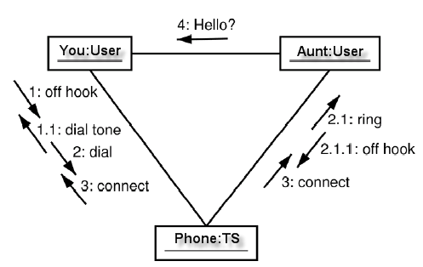
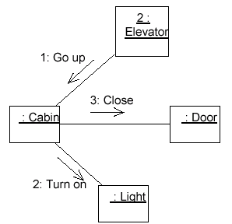
Collaboration Diagram

Slide 65


Activity Diagrams
Fancy flowchart
  Displays the flow of activities involved in a single process
  States
    Describe what is being processed
    Indicated by boxes with rounded corners
  Swim lanes
    Indicates which object is responsible for what activity
  Branch
    Transition that branch
    Indicated by a diamond
  Fork
    Transition forking into parallel activities
    Indicated by solid bars
  Start and End

Slide 66
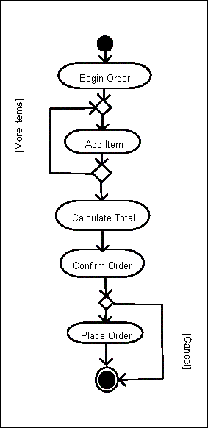
Sample Activity Diagram
Ordering System
May need multiple diagrams from other points of view

Slide 67

Activity Diagram Example

Slide 68
State Transition Diagrams
Fancy version of a DFA
Shows the possible states of the object and the transitions that cause a change in state
  i.e. how incoming calls change the state
Notation
  States are rounded rectangles
  Transitions are arrows from one state to another. Events or conditions that trigger transitions are written beside the arrows.
  Initial and Final States indicated by circles as in the Activity Diagram
    Final state terminates the action; may have multiple final states

Slide 69
State Representation
The set of properties and values describing the object in a well defined instant are characterized by
  Name
  Activities (executed inside the state)
    Do/ activity
  Actions (executed at state entry or exit)
    Entry/ action
    Exit/ action
  Actions executed due to an event
    Event [Condition] / Action ^Send Event

Slide 70
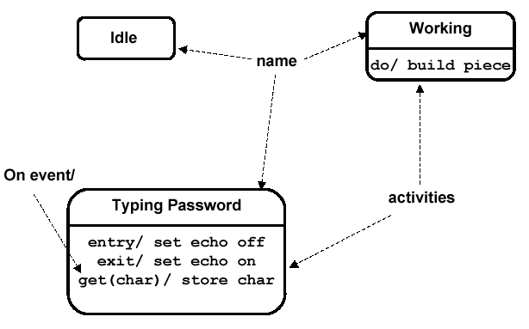
Notation for States

Slide 71
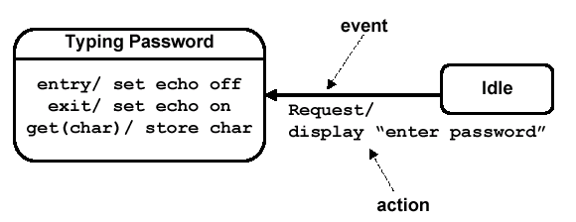
Simple Transition Example

Slide 72
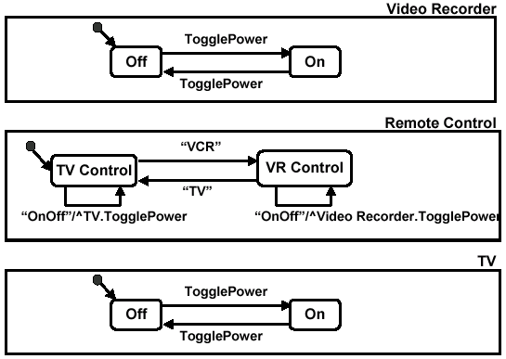
More Simple State Examples

Slide 73
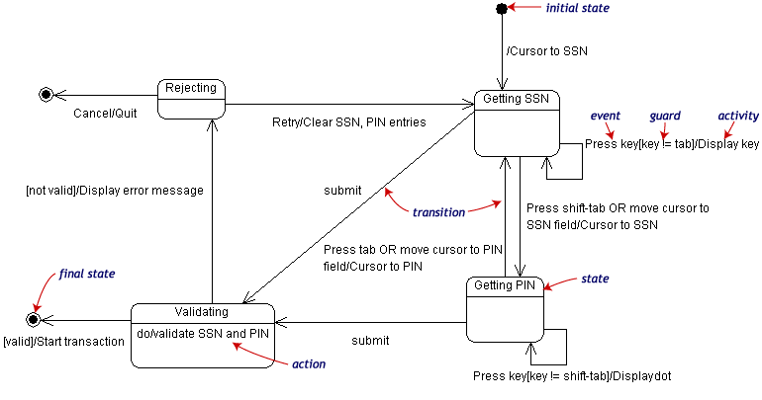
State Transition Example
Validating PIN/SSN

Slide 74
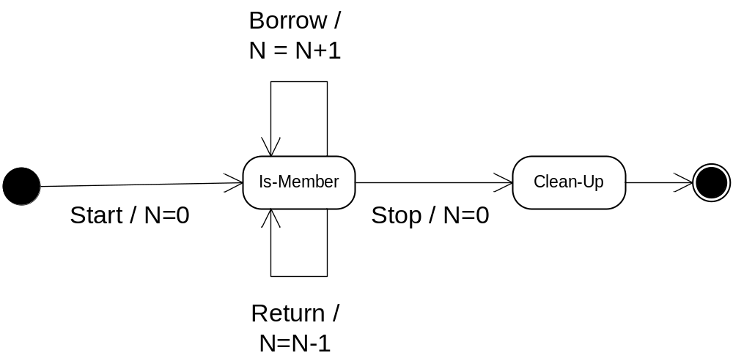
State Charts – Local Variables
State Diagrams can also store their own local variables, do processing on them
Library example counting books checked out and returned

Slide 75
Component Diagrams
Shows various components in a system and their dependencies, interfaces
Explains the structure of a system
Usually a physical collection of classes
  Similar to a Package Diagram in that both are used to group elements into logical structures
  With Component Diagrams all of the model elements are private with a public interface whereas Package diagrams only display public items.

Slide 76


Component Diagram Notation
Components are shown as rectangles with two tabs at the upper left
Dashed arrows indicate dependencies
Circle and solid line indicates an interface to the component

Slide 77
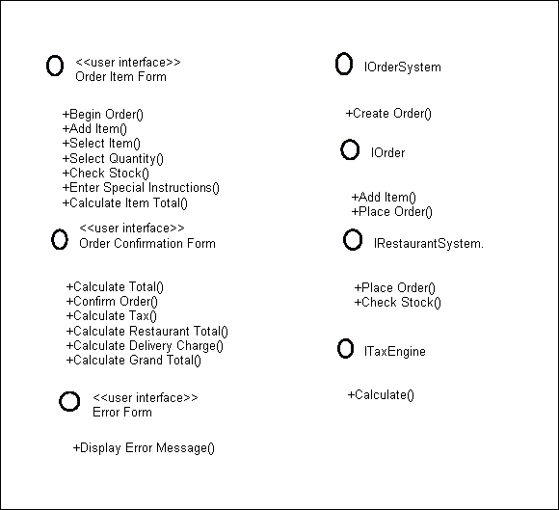
Component Example - Interfaces
Restaurant ordering system
Define interfaces first – comes from Class Diagrams

Slide 78
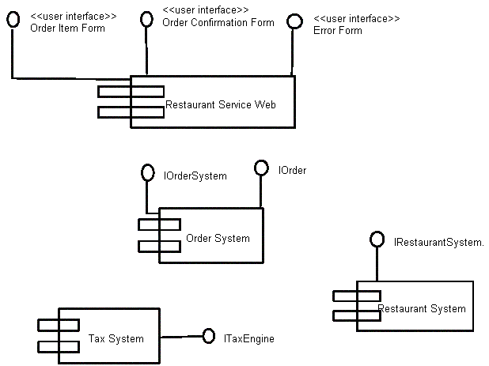
Component Example - Components
Graphical depiction of components

Slide 79
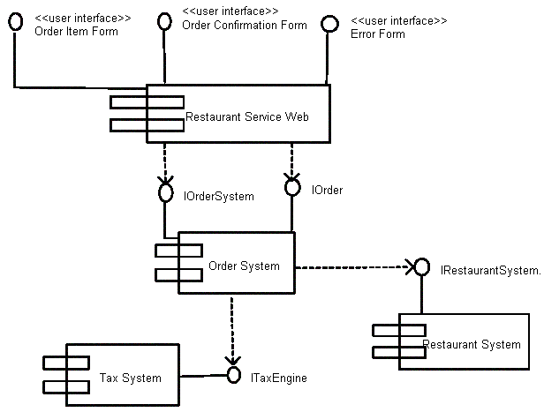
Component Example - Linking
Linking components with dependencies

Slide 80
Deployment Diagrams
Shows the physical architecture of the hardware and software of the deployed system
Nodes
  Typically contain components or packages
  Usually some kind of computational unit; e.g. machine or device (physical or logical)
Physical relationships among software and hardware in a delivered systems
  Explains how a system interacts with the external environment

Slide 81
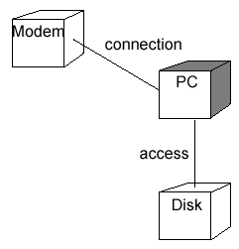
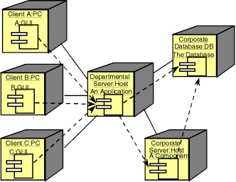
Some Deployment Examples

Slide 82
4. REQUIREMENTS ELICITATION
4.1 Introduction
  Requirements Engineering – process of developing the requirements of the system
    Requirements Elicitation – specification of what the user/client wants, including goals and constraints, that must be completely and unambiguously captured using both the user/client and developer terminologies and representation paradigms
    Scenarios and Use Cases (from the developer’s paradigm) are used to bridge the semantic gap between the user/client and the developer during requirements elicitation
    Requirements Analysis – a model that the developer can unambiguously interpret
    Scenarios: Describe a series of interactions between the user the system
    Use Cases: An abstraction of a set of scenarios, written in natural language form or modeled diagrammatically
    After elicitation, user/client validate the scenarios by testing small prototypes provided by the developer
    Testing elicited specifications exposes errors (due to miscommunication or misunderstanding), which are difficult to correct later, and facilitated by user feedback
    Scenario development – a methodology for modeling the application domain by observing user environment (task analysis)

Slide 83
4.2 OVERVIEW OF REQUIREMENTS ELICITATION
System Specification – Users identification and subsequent definition of the problem, which serves as the contract between user/client and the developer
System Analysis – a process which formalizes the system specification to produce an analysis model
The only difference between an SS and SA is the language and notation used in their representation – SS is usually in a natural language representation and an SA in a formal or semiformal representation.
An SS document is used for user/client and developer communication
An SA document is used for among developers communication
Both SS and SA focus on user perspective of the system in terms of functionality, interactions between user and the system, errors the system can detect and handle,exceptional cases, the operating environment of the system
See Fig 4-1

Slide 84
Requirements
Elicitation
system
specification
:Model
Analysis
analysis model
:Model
Figure 4-1. Products of requirements elicitation and analysis (UML activity diagram).

Slide 85
OVERVIEW OF REQUIREMENTS ELICITATION - 2
Requirements Elicitation Activities
  Identifying Actors: developers identify the different types of users of the proposed system
  Identifying Scenarios: developers observe users and develop a set of detailed scenarios of system functionality, and use the scenarios to communicate with user to further understanding of the system
  Identifying use cases: allows abstract placement of scenarios into scopes
  Refining use cases: play-back of scenarios to expose errors, incompleteness, testing exceptional conditions, and demonstration of system behavior
  Identifying relationships among use cases: consolidation of use cases to eliminate redundancies and maintain consistency
  Identifying nonfunctional requirements: inclusion of constraints that satisfy such measures as performance, documentation, resource specificities, security, quality, safety, reliability, fitness into operating environment

Slide 86
4.3 REQUIREMENTS ELICITATION CONCEPTS
Functional Requirements
  Description of interactions between the system and its environment (independent of its implementation)
  Example – the SatWatch system’s functional requirements focus on possible interactions between the SatWatch (itself) and its external world (the owner, the GPS, the WebifyWatch API), nothing about its makeup – processor, language, display technology, etc.
Nonfunctional and Pseudo Requirements
  Description of user-visible (constraints) aspects, not directly related basic functionality of the system. These include quantitative constraint: performance, response time, accuracy (margin of tolerant error), acceptable range or condition of operation
Pseudo Requirements:
  Constraints that restrict implementation platform and language, imported subsystems, and policy issues of user that developer must adhere to

Slide 87
REQUIREMENTS ELICITATION CONCEPTS - 2
Analysis versus Modeling
  Analysis is a modeling activity (formulation process), the model describes the reality of user’s view
  Modeling is identifying and classifying real-world phenomena (reality) into concepts
  A correct model allows a total mapping of concepts to relevant phenomenon (closure)
  A complete model captures or models all phenomenon (total placement into at least one concept)
  A consistent model presents a phenomenon in a single, same reality at all times (singularity)
  See Fig 4-2

Slide 88
1
*
Model
System
describes
*
*
Concept
Phenomenon
Figure 4-2. A System is a collection of real world Phenomena. A Model is a collection of Concepts that represent the System’s Phenomena. Many Models can represent different aspects of the same System. An unambiguous Model corresponds to only one System.

Slide 89
REQUIREMENTS ELICITATION CONCEPTS - 3
Levels of Description
  At the operating environment level - objects that interactions with the target system, including mechanisms for accommodating the dynamics of the changing environment
  Levels:
    Work division: set of use cases describing the work processes, focusing on the boundaries between the users and the system
    Application-specific system functions: set of use cases describing system functions in the application domain
    Work-specific system functions: set o fuse cases describing the supporting functions, which are not directly related to the application domain (e.g., supporting DBMS, OS, GUI, management functions, boundary issues like system shutdown, initialization, and exception)
    Dialog: set of use cases describing the interactions between users and the user interfaces of the system (focus on control flow and input/output layout issues)

Slide 90
REQUIREMENTS ELICITATION CONCEPTS - 4
Correctness, Completeness, Consistency, Clarity and Realism
  Requirements specification is validated by satisfying these five criteria
  Correctness: Every aspect of the model captures a user viewpoint or phenomenon
  Completeness: Every possible scenarios is modeled or conceptualized in the specification
  Consistency: When the specification contains no contradictions (syntactically and semantically)
  Clarity: When the specification is void of ambiguities, that the model mirrors the same system
  Realism: Could the system, as specified, be implemented within constraints, otherwise certain assumptions or refinement or reduction of size/complexity is warranted. Typically, rapid prototyping or simulation of complex or high-risk components of the system could be done and evaluated to estimate the extent of realism.
  (Ref. Table 4-1)

Slide 91
REQUIREMENTS ELICITATION CONCEPTS - 5
Verifiability and Traceability
  Verifiability – a measure of the (built) system’s ability to repeat (or reproducibility of) the same results for repeated test cases, which meet the user requirements within the given constraints or assumptions
  Traceability – a measure of a mapping from system functions onto a set of user requirements through systematic validation of the system design
  Classification of Requirement Elicitation Activities
    Greenfield Engineering – A non-existing system, spawned by a user need or new markets
    Reengineering – Spawned by technology enablers or functional changes, a system is redesigned and reimplemented
    Interface Engineering – An existing, or legacy, system is given a new interface subsystem without affecting the system itself

Slide 92
4.4 REQUIREMENTS ELICITATION ACTIVITIES
Requirements elicitation activities constitute a step by step process for mapping the user problem statement into a system specification, formally represented as a set of actors, scenarios, and use cases.
The RE Methods or Activities:
  Identifying actors
  Identifying scenarios
  Identifying use cases
  Refining use cases
  Identifying relationships among use cases
  Identifying participating objects
  Identifying nonfunctional requirements

Slide 93
REQUIREMENTS ELICITATION ACTIVITIES - 2
Identifying Actors –
  Actors are entities external to the system itself. Actors interact with the system from outside, defining the classes of functionality or roles. E.g., the GPS, owner, and WebifyWatch are actors to the SatWatch system; or the Dispatcher, FieldOfficer, and Database actors in the FRIEND system
  Identifying actors define the boundaries of the system, and the actors define the roles in the organization (from the external point of view or usage of the target system)

Slide 94
REQUIREMENTS ELICITATION ACTIVITIES - 3
Identifying Scenarios –
  Following the actor identification, is the determination of the functionalities or roles of each actor
  A scenario is derived from a single user/actor perspective, which represents an informal but concrete description of the actor’s role or a feature of the system
  Scenarios are open ended, informal, refineable and depart from the traditional system-centered representations, offering a simplified level of understanding for user/client and developer
  Scenarios Types:
    As-is scenarios – describe the current situation (esp. for reengineering systems) and relative easy to validate
    Visionary scenarios – describe a future system, and useful as a design representation to refine ideas, communication tools for client and developer, or prototyping tool.
    Evaluation scenarios – represent user tasks for measuring/evaluating/testing the system
    Training scenarios – tutorials for acquainting new users with the system
  To identify scenarios, focus is on: tasks from actors’ perspective, info actors need/access, who creates data, what external entities do actors create/change/request for the system, which events impact the actor?
  (See Fig 4-5)

Slide 95
REQUIREMENTS ELICITATION ACTIVITIES - 4
Identifying Use Cases
  Scenarios are instances of a use case in that each use case captures a given functionality expressed as a set of scenarios
  Each use case is initiated by an actor, and later interacted with by other actors
  A use case represents a complete flow of events through the system, describing a series of interactions
  A use case can be refined (as in scenarios) through various levels of details
  (See Fig 4-6)

Slide 96
REQUIREMENTS ELICITATION ACTIVITIES - 5
Refining Use Cases
  A use case is refined by adding details of roles and interactions of actors
  The focus of use case refinement is on completeness and correctness of the specification, by identifying functionalities not previously covered by the sets of scenarios, including rare conditions and exception handling
  Refinement of use cases through consolidation and reorganization allows traceability and redundancy in use cases to be removed
  Scenarios and Use Case Heuristics:
    Use scenarios to communicate with users and to validate functionality
    First, refine a narrow vertical slice (I.e., one scenario) to understand the user’s preferred style of interaction
    Next, define a horizontal slice (I.e., many not-very-detailed scenarios ) to define the scope of the system
    Use mock-ups as a visual support only, user interface design should occur as a separate task once functionality is sufficiently stable
    Present the user with multiple alternatives (as opposed to extracting a single alternative from the user)
    Detail a broad vertical slice when the scope of the system and the user preferences are well understood.

Slide 97
REQUIREMENTS ELICITATION ACTIVITIES - 6
Identifying Relationships among Actors and Use Cases
  Modeling relationships among actors and use cases reduce complexity and enhances understandability. Three (3) types of relationships are used:
  Communication Relationships
    Describe the system’s layers of functionality, representing the flow of information from (initiating/sending) actors to use cases that receiving the ‘signals’ and to those actors who receive communication from use cases. Access control (which actor has access to which use case) and event flow are represented in use cases with lines/links
  See Fig 4-8

Slide 98
<<initiate>>
FieldOfficer
Dispatcher
OpenIncident
ReportEmergency
AllocateResources
Figure 4-8. Example of communication relationships among actors and use cases in FRIEND (UML use case diagram). The FieldOfficer initiates the ReportEmergency use case and the Dispatcher initiates the OpenIncident and AllocateResources use cases. FieldOfficers cannot directly open an incident or allocate resources on their own.

Slide 99
REQUIREMENTS ELICITATION ACTIVITIES - 7
Extend relationships between use cases
  A use case extends another use case if the extending use case allows separation of exceptional or optional or seldom-occurring flow of events from the base use cases.
  The extended use case is functionally complete, with its own entry/exit conditions and provides services to the base use cases
  The condition under which the extended use case is initiated is specified in the extended use case as an entry condition
  The extended use case is ‘linked’ to the base use case(s) with a broken arrow pointing from the extended use case to the base use case(s)
  See Fig 4-9

Slide 100
FieldOfficer
ConnectionDown
ReportEmergency
<<extend>>
Figure 4-9. Example of use of extend relationship (UML use case diagram). ConnectionDown extends the ReportEmergency use case. The ReportEmergency use case becomes shorter and solely focused on emergency reporting.

Slide 101
REQUIREMENTS ELICITATION ACTIVITIES - 8
Include Relationships between use cases
  An include use case factors out shared or common behavior among base use cases
  Behavior is factored out if it is shared among two or more base use cases, reducing redundancy in the use case models
  In the include use case, the conditions under which the included use case is initiated is specified in the base or initiating use cases
  The included use case is ‘linked’ to the base use case(s) with a broken arrow pointing from the base use cases to the included use case(s)
  See Fig 4-10 and Fig 4-11

Slide 102
<<include>>
OpenIncident
ViewMap
<<include>>
AllocateResources
Figure 4-10. Example of include relationships among use cases. ViewMap describes the flow of events for viewing a city map (e.g., scrolling, zooming, query by street name) and is used by both OpenIncident and AllocateResources use cases.

Slide 103
REQUIREMENTS ELICITATION ACTIVITIES - 9
Identifying Initial Analysis Objects
  Following agreement on the use of consistent terminologies, developers identify the participating objects for each use case.
  The participating objects correspond to the main concepts in the application domain (identified and collated into a glossary by name and description)
  The glossary is used in preparing manuals, educate new users and developers
  The participating objects constitute the initial analysis model
  Heuristics for identifying the participating objects:
    Terms that developers or users need to understand the use case
    Recurring nouns in the use cases
    Real-world entities that the system keeps track of (e.g., resources)
    Real-world processes that the system keeps track of
    Use cases
    Data sources or sinks
    Interface artifacts
    Using application domain terms

Slide 104
REQUIREMENTS ELICITATION ACTIVITIES - 10
Aspects and guidelines for identifying or naming participating objects:
  If two use cases refer to the same concept, their object names should be the same
  If two objects of the same name correspond to two different concepts, one must be renamed
  Associating participating objects with use cases:
  Which use case creates the object? (I.e., in which use case are object attribute values assigned?)
    Which use case modifies or removes the object, and which actor initiates this action?
    Is the object relevant to any use case?

Slide 105
REQUIREMENTS ELICITATION ACTIVITIES - 11
Heuristics for cross-checking use cases, participating objects, and impact of new perspectives
  In which use cases are the participating objects defined or entered in the system
  Which actors can access these objects, which use cases modify/edit/remove the object
  Which actor(s) can initiate the use case
  Does every object have at least one association or used in at least one use case
  New uses cases developed due to perspective changes can trigger integration or modification of use cases, which may trigger generation or refinement of participating objects and their interactions

Slide 106
REQUIREMENTS ELICITATION ACTIVITIES - 12
Identifying non-functional requirements
  Issues that define non-functional requirements may include:
  The look of user-interface or GUI, system response time, deadline requirements, safety and security requirements, size of systems, cost factors, portability
  To Elicit Non-functional Requirements, follow:
    Interface – kind and level of user’s sophistication
    Documentation – level of detail, kind (for user, client, management, technical, process)
    Hardware considerations – compatibility issues, hw interactions (esp. for embedded systems)
    Performance – system responsiveness, concurrent or single-user support, throughput, load
    Error Handling – exceptions (how and who – system or user), effect of operational environ, safety
    Quality – level of reliability, availability, fault tolerance, robustness, which the client desires
    System changes – extent of it in the future and rationale/responsibility of changes
    Physical Environment – operation environment for deployment, external factors (weather/climate)
    Security – access limitation and protection, level of security (user, client, manager, operators)
    Resources – e.g. memory limitations, power requirements (can impact the kind/size of code to fit the constraints)

Slide 107
MANAGING REQUIREMENTS ELICITATION
Post elicitation activities aimed at: Tools/techniques/steps; agreement with client; validating elicited info - usability testing; reporting or documentation
Tools/Techniques:
  Task analysis based on developer’s observation user’s day-to-day performance (The What’s, Why’s – using, e.g., the Knowledge Analysis of Tasks (KAT) tool.)
  KAT steps:
    identify objects and their associated actions from books, manuals, reports, interviews/observe
    Identify procedures (sets of actions), procedure pre- and post-conditions, triggers, scenarios
    Identify goals and objectives for each task during interviews, decompose goals into subgoals
    Determine the relevance of each object (ordering by significance) toward achieving goals
    Construct a model of the task – may use matrix models, tables, cross-referencing techniques

Slide 108
MANAGING REQUIREMENTS ELICITATION - 2
AGREEING/NEGOTIATING WITH CLIENT
  Based on an IBM Joint Application Design (JAD) method for consensus building on requirements elicitation involving all stakeholders in a single session
  JAD document content:
    Data dictionary, work flows, interface screens
  JAD Activities and Products
  (See Fig 4-12)

Slide 109
Project
definition
Management
definition guide
Research
Preliminary specification
Session agenda
Preparation
Figure 4-12. Activities of JAD (UML activity diagram). The heart of JAD is the Session activity during which all stakeholders design and agree to a system specification. The activities prior to the Session maximizes its efficiency. The production of the Final document ensures that the decisions made during the Session are captured.
Session script
Working document
Session
Scribe forms
Final document
preparation
Final document

Slide 110
MANAGING REQUIREMENTS ELICITATION - 3
Validating Elicited Data – Usability Testing
Is the use case model comprehensible to the user/client?
  User testing/exploring the requirements data for validation purpose
  User interface details (understanding metaphors used)
  Approaches:
    Classical controlled experiment seeking refutation of hypothesis – empirical analysis of experimental parameters
    Usability tests based on evaluating the parameters that define the ease or difficult of use of the system for qualitative purposes
  Types of Usability Tests (at the RE phase)
    Scenarios – presenting user with visionary scenarios for understanding, accuracy, reaction/acceptance, and realism; cheap, allows rapid feedback, paper-design/sketches done in a prototyping environment
    Prototype – actual code segment that exercises system’s (superficial) functionality using vertical testing (depth of a use case) or horizontal testing (focusing on interfaces across many use cases), if carefully done can be reused in actual system; more realistic but expensive
  (See Rubin ’94 and Nelsen/Mack ’94 papers)

Slide 111
MANAGING REQUIREMENTS ELICITATION - 4
Documents Requirements Elicitation
  Prepared at when use case model stabilizes, published and baselined
  Becomes a deliverable – placed under configuration management
  (See RAD table)

Slide 113
Real-time requirements
Intro to Software Engineering
Software Development Process Models
Formal methods in software specification
Structured Analysis
Object-oriented analysis and the UML
  Use Cases

Slide 114
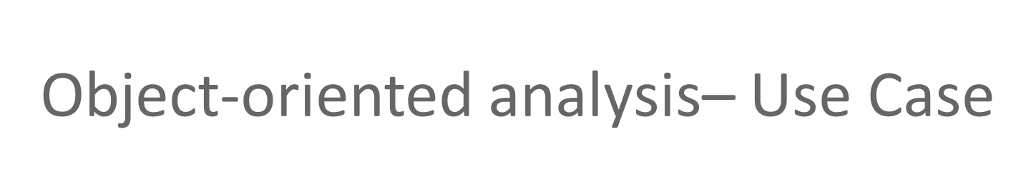
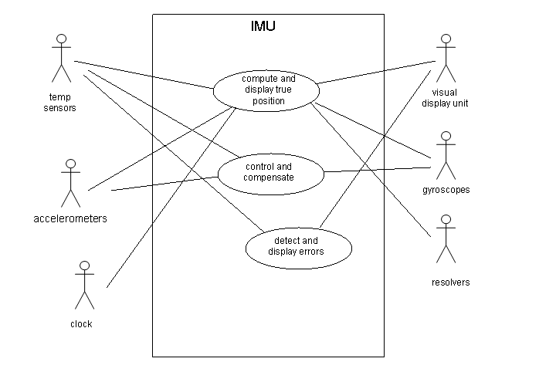
Use Case diagram of inertial measurement system.

Slide 115

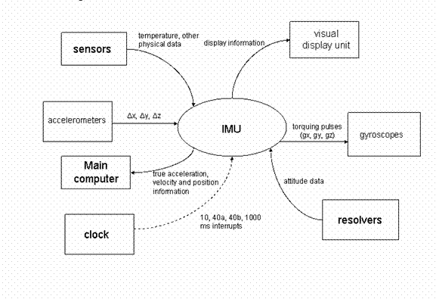
Inertial Measurement System

Slide 116

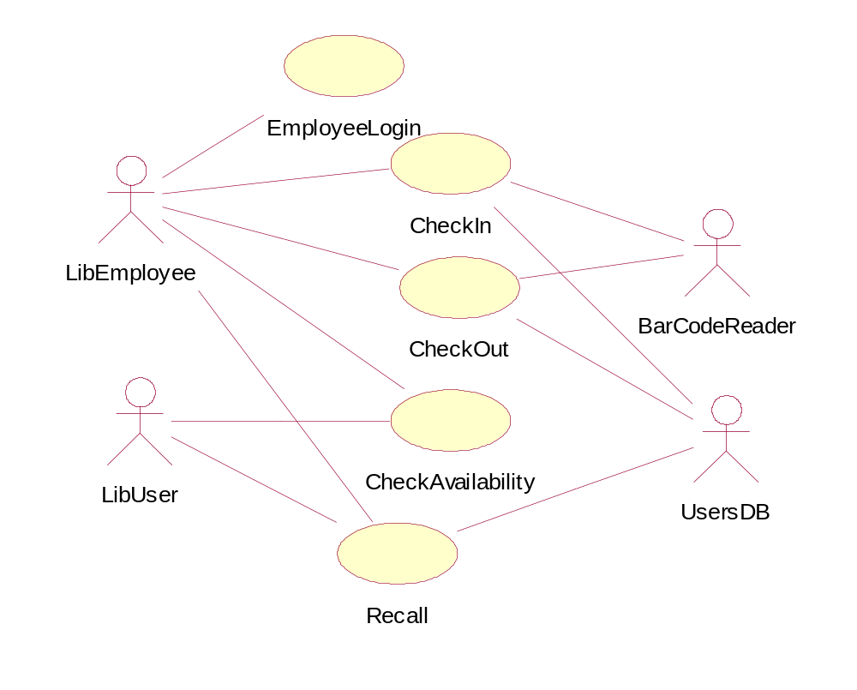
A computerized library system for a university keeps track of all books and periodicals in the library and their check-out status. Checkout and return are automated through a bar code reader (an external device). The library system also interfaces with an external relational database which stores information about the library users (students, faculty, and staff), including whether they have any library items checked out. . Library users can access the catalog and recall books and periodicals. Library employees have the same access as well as additional capabilities (e.g., listing the status of an item). (Note: the library catalog is part of the library computer system so it is not shown as an actor.)

Slide 117
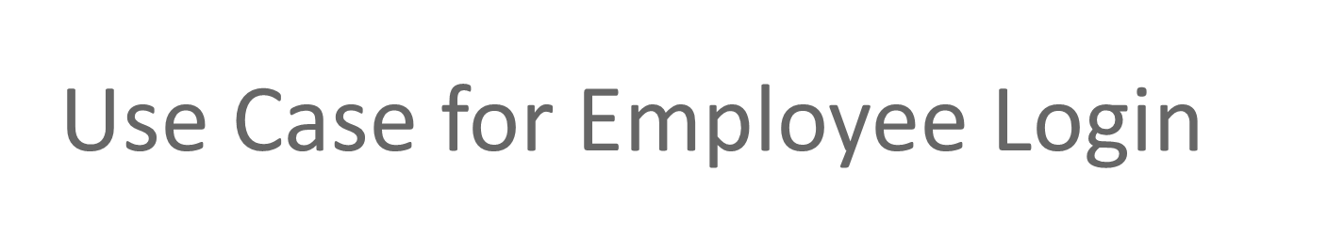
Employee initiates use case by entering user name
System prompts for password
If password is valid, employee is logged on and now has access to employee commands
Starting and Ending Conditions?
Exceptions? e.g., cannot find the employee login

Slide 118
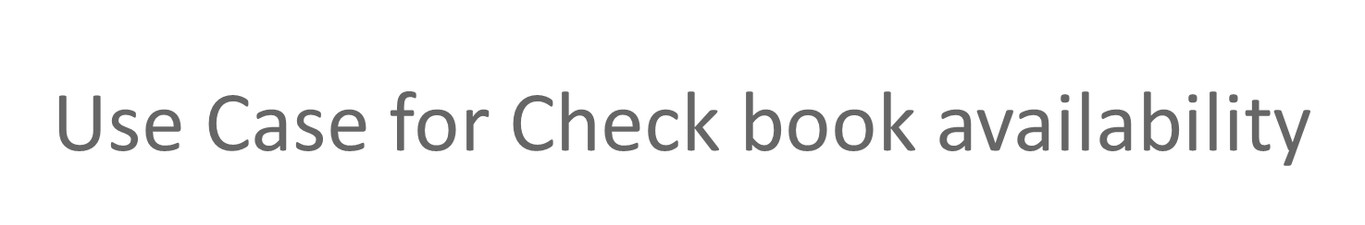
User/Employee initiates use case by selecting the check book availability option
System prompts for choice of search by title, author, or call number
User makes selection and enters title, author or call number
System performs search through the library catalog database
If a match is found, system displays item status (not checked out, checked out and due date, overdue)
Starting and Ending Conditions?
Exceptions?

Slide 119
<<Include>>: Functional Decomposition
Problem:
  A function in the original problem statement is too complex to be solvable immediately
Solution:
  Describe the function as the aggregation of a set of simpler functions. The associated use case is decomposed into smaller use cases
CreateDocument
<<include>>
<<include>>
<<include>>
Scan
OCR
Check

Slide 120
<<Include>>: Reuse of Existing Functionality
Problem:
  How can we reuse existing functions?
Solution:
  The include association (“A delegates to B”)
Note: The base case cannot exist alone. It is always called with the supplier use case
<<include>>
OpenIncident
Base Use
Case
ViewMap
<<include>>
Supplier
Use Case
AllocateResources

Slide 121
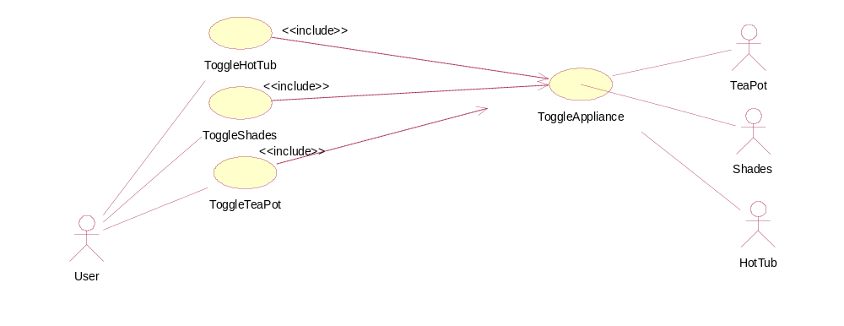
Home Automation example – factor out common functionality

Slide 122
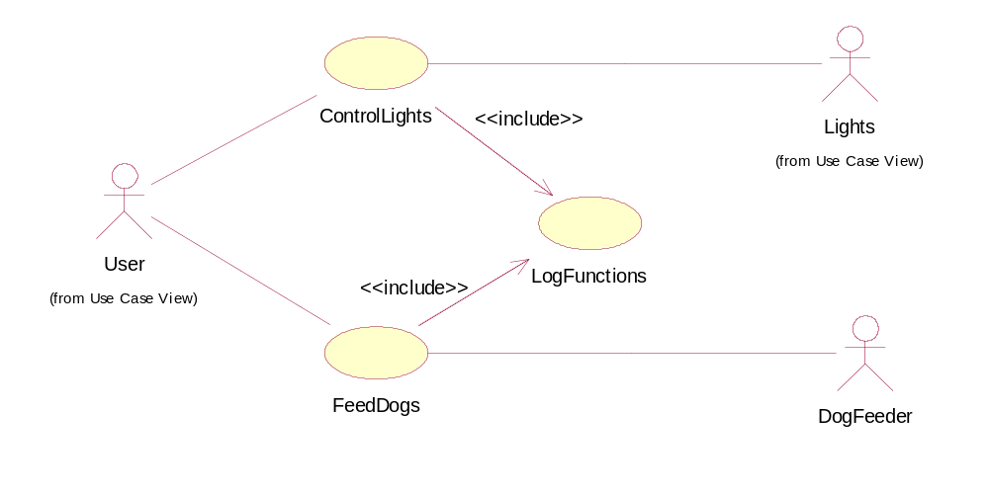
Another Home Automation example –
factor out common functionality

Slide 123
<<Extend>> Association for Use Cases
Problem:
  The functionality in the original problem statement needs to be extended.
Solution:
  An extend association: B is an extension of A.
Note: In an extend association, the base use case can be executed without the use case extension
Base Use
Case
B
Help
FieldOfficer
A
<<extend>>
ReportEmergency

Slide 124

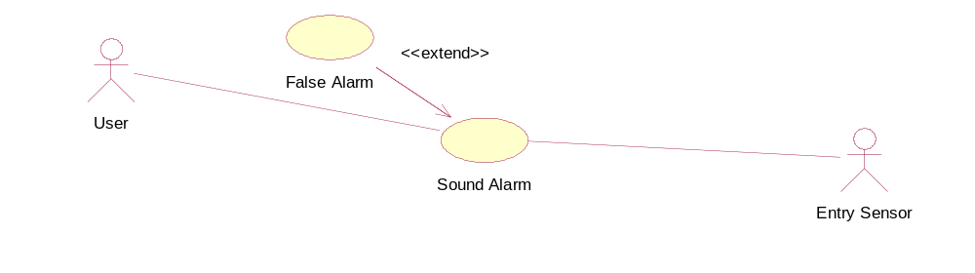

Slide 125
Generalization association in use cases
Problem:
  You have common behavior among use cases and want to factor this out.
Solution:
  The generalization association factors out common behavior.
CheckPassword
Parent
Case
ValidateUser
Child
Use Case
CheckFingerprint

Slide 126
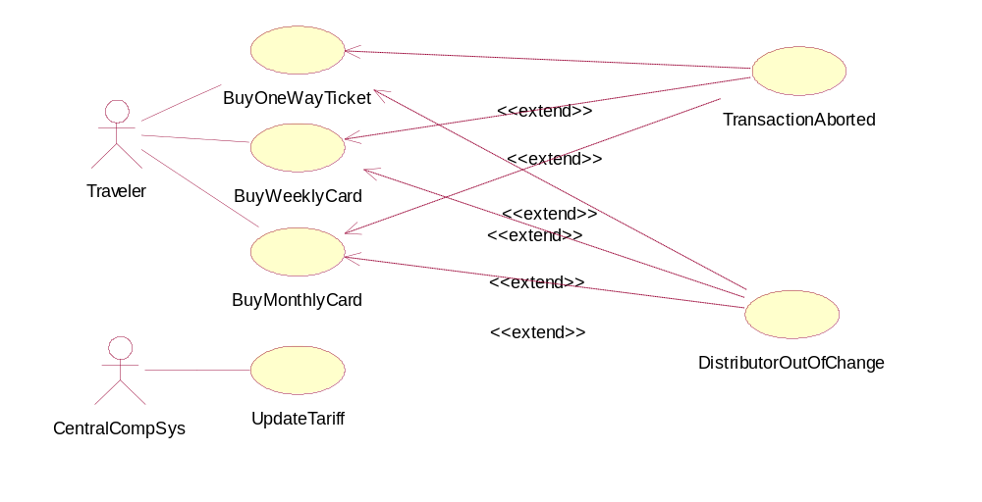
Example using <<extend>>

Slide 127
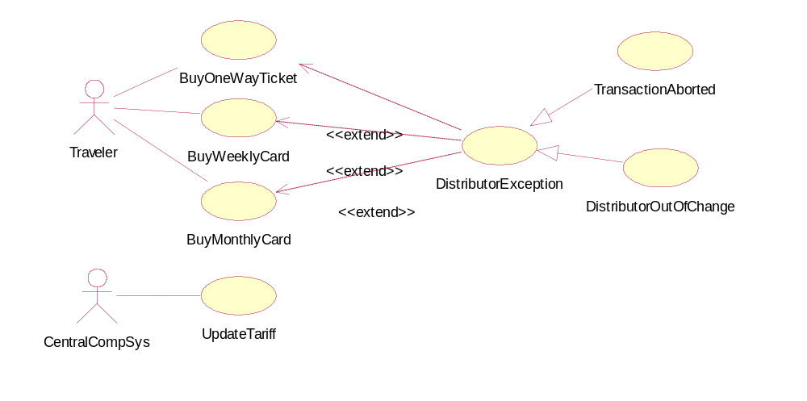
Simplified with an abstract use case

Slide 128
Good Practice: CRC Card
(Class Responsibility Collaborator)
Benefits: It is easy to describe how classes work by moving cards around; allows to quickly consider alternatives.
Class
Reservations
Collaborators
Catalog
User session
Responsibility
Keep list of reserved titles
Handle reservation

Slide 129
Sequence Diagram(make a phone call)
Caller
Phone
Recipient
Picks up
Dial tone
Dial
Ring notification
Ring
Picks up
Hello

Slide 130
Sequence Diagram: Object interaction
A
B
Self-Call: A message that an
Object sends to itself.
Condition: indicates when a message is sent. The message is sent only if the condition is true.
Synchronous
Asynchronous
Transmission delayed
Condition
[condition] remove()
Iteration
*[for each] remove()
Self-Call

Slide 131
Sequence Diagrams – Object Life Spans
Creation
  Create message
  Object life starts at that point
Activation
  Symbolized by rectangular stripes
  Place on the lifeline where object is activated.
  Rectangle also denotes when object is deactivated.
Deletion
  Placing an ‘X’ on lifeline
  Object’s life ends at that point
A
Create
B
Activation bar
X
Return
Deletion
Lifeline

Slide 132
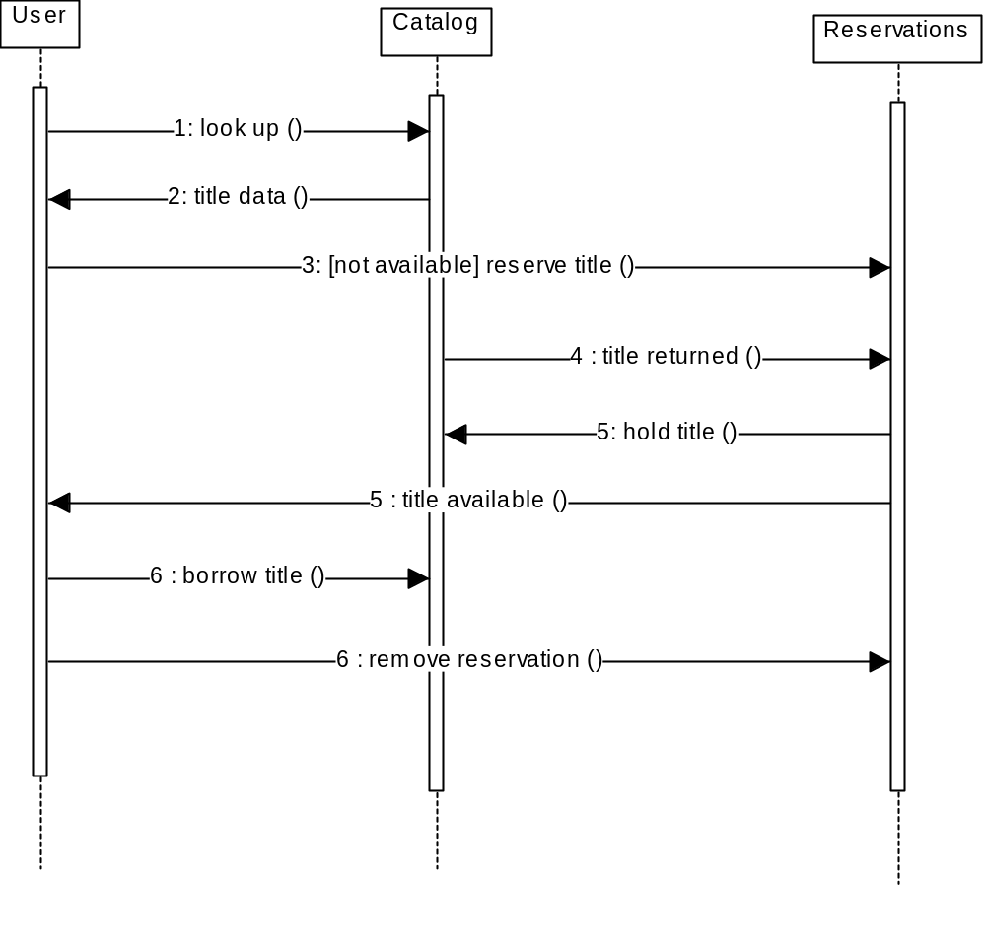
Sequence Diagram
Message
Sequence diagrams demonstrate the behavior of objects in a use case
by describing the objects and the messages they pass.
The horizontal dimension shows the objects participating in the interaction.
The vertical arrangement of messages indicates their order.
The labels may contain the seq. # to indicate concurrency.

Slide 133
Interaction Diagrams: Collaboration diagrams
start
6: remove reservation
3 : [not available] reserve title
User
Reservations
6 : borrow title
5: title available
2: title data
1: look up
4 : title returned
Catalog
5 : hold title
Shows the relationship between objects and the order of messages passed between them.
between them.
The objects are listed as rectangles and arrows indicate the messages being passed
The numbers next to the messages are called sequence numbers. They show the sequence
of the messages as they are passed between the objects.
convey the same information as sequence diagrams, but focus on object roles instead of the
time sequence.

Slide 134
State Diagrams (Billing Example)
State Diagrams show the sequences of states an object goes through during its life cycle in response to stimuli, together with its responses and actions; an abstraction of all possible behaviors.
Start
End
Unpaid
Paid
Invoice created
paying
Invoice destroying

